Slide 1

GROUP PROJECT 1
Team 7
(Palle, Steven, Sunny)

Slide 2

Introduction
We focused on analyzing the relationships between key social determinants—such as employment, income, and healthcare provider availability—and their impact on specific health outcomes.
We are particularly interested in:
Assessing how unemployment levels influence drug overdose deaths.
Understanding the relationship between income levels and maternal mortality rates.
Examining the role of mental healthcare providers in managing and reducing depression rates.
By exploring these dynamics, we aim to identify meaningful patterns and correlations that can inform evidence-based interventions. Our ultimate goal is to leverage these insights to enhance overall health outcomes and guide strategic decision-making for improving public health.

Slide 3
DATASET
AHRQ : Social Determinants of Health Database (2019-2020)
Developed by the Agency for Healthcare Research and Quality (AHRQ)
Provides county-level data on social , economic and healthcare factors.
Enables analysis of social determinants and their impact on health outcomes.
It serves as a valuable resource for public health professionals, policymakers and researchers.

Slide 4
Specific Question 1
To what degree does unemployment influence drug overdose deaths?

Slide 5
Variables
Unemployment Rate
Drug Overdose Death Rate

Slide 6
EDA
Histograms
Scatterplots

Slide 7

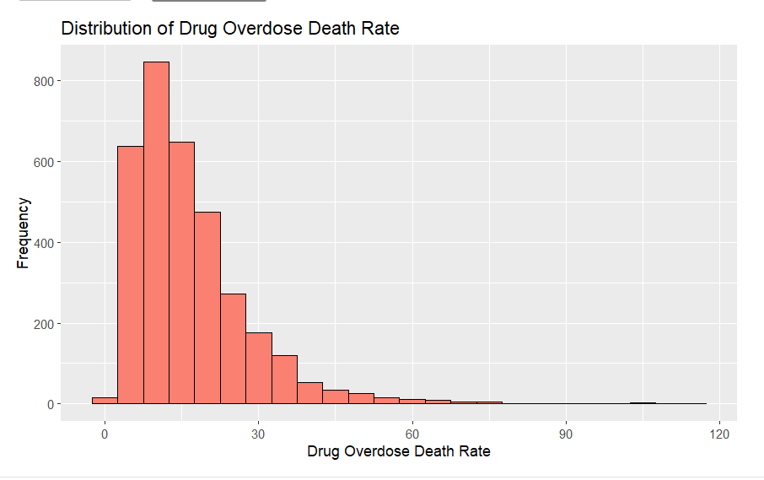
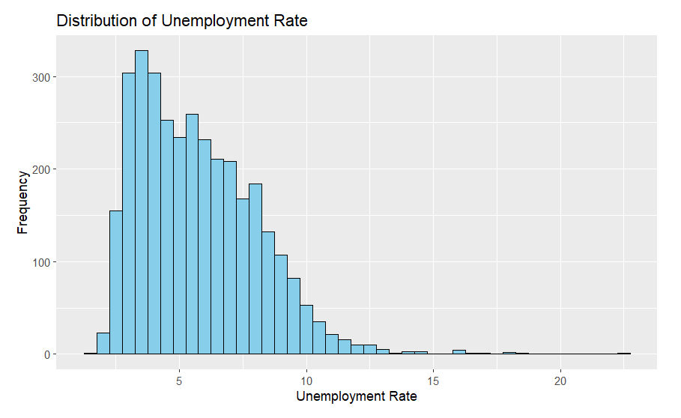
HISTOGRAMS
Right Skewed.
Most counties have low unemployment rate and low drug overdose death rate.
Very less counties have high unemployment rate and high drug overdose death rate.

Slide 8
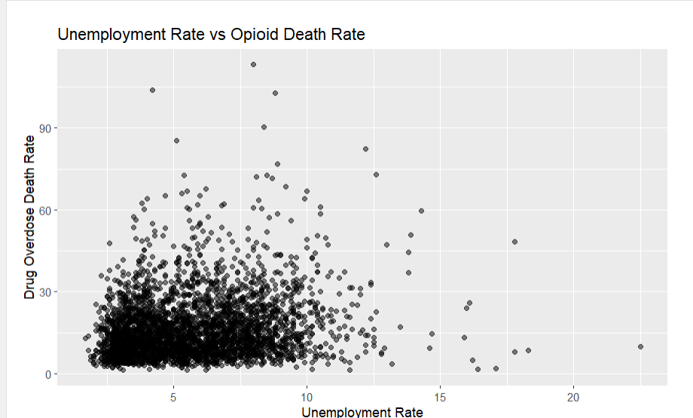
SCATTERPLOT
Large Cluster at low unemployment rates and Drug overdose death rate
Showing Weak relation between Unemployment rate and Drug overdose death rate

Slide 9
Correlation Analysis
Result : 0.18017
Which suggest a weak positive relationship between Unemployment Rate and Drug Overdose Death Rate

Slide 10
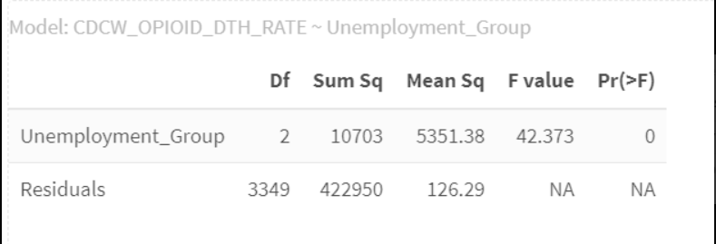
ANOVA TEST
F value = 42.373
Pr(>F) = 0
This result indicates that unemployment levels do influence drug overdose death rates

Slide 11
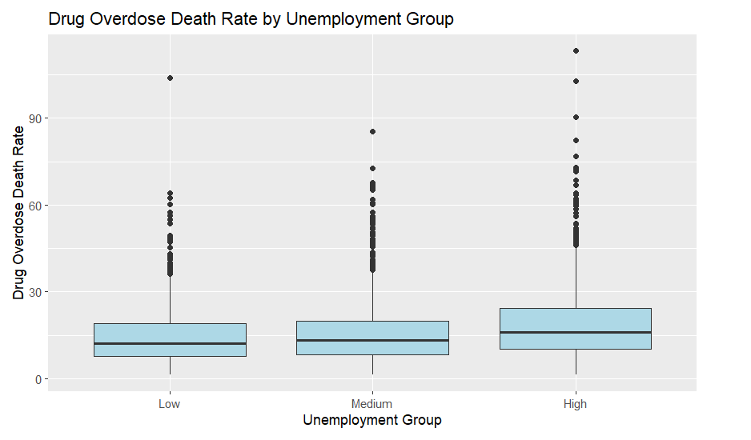
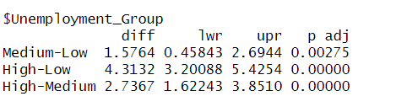
TUKEY HSD POST HOC
From the tukey test and the boxplot we can confirm that there is a positive relationship between Unemployment Rate and Drug Overdose Death Rate

Slide 12
Specific Question 1 conclusion
From the above analysis we can conclude that there is a very weak positive but significant relation between Unemployment Rate and Drug Overdose Death Rate.

Slide 13
Specific Question 2
To what degree does the number of mental healthcare providers influence depression?

Slide 14

VARIABLES
Total mental health care providers
Prevalence of depressive disorders

Slide 15
EDA
Histograms
Scatterplot

Slide 16
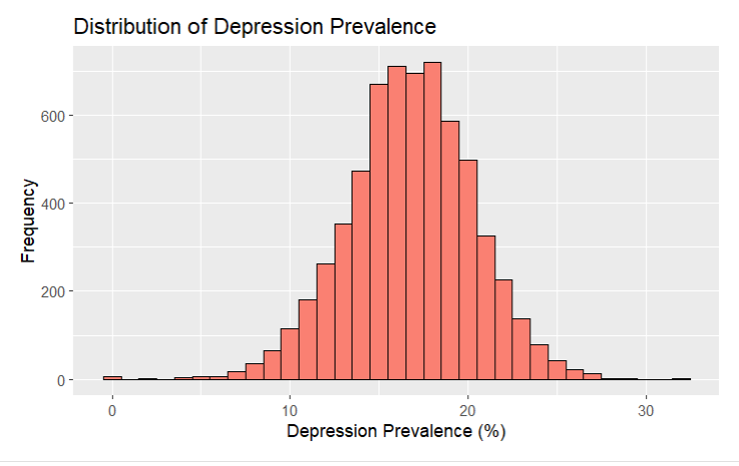
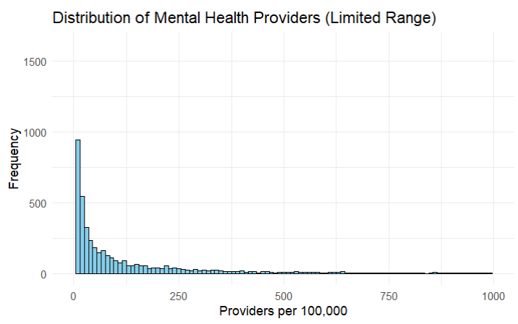
Histograms
The histogram for mental health providers is heavily Skewed to the right showing that for most counties mental healthcare providers are low
The histogram for Depression Prevalence is Bell shaped stating very few counties have low or high depression prevalence

Slide 17
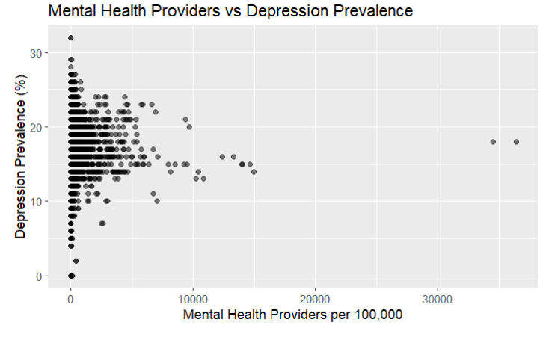
Scatterplot
From the scatterplot we can say that number of mental health care providers doesn’t have a strong direct influence on depression rates

Slide 18
Correlation Analysis
Result : 0.031033
The above result suggests that the number of mental health care providers has little to no direct influence on Depression Rates

Slide 19

ANOVA TEST
F value = 180.75
Pr(>F) = 0
The results show that grouping of provider levels does have significant effect on depression prevalence

Slide 20
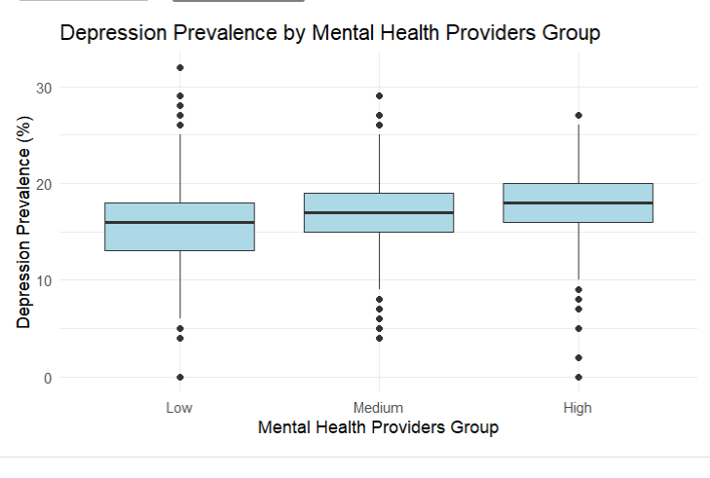
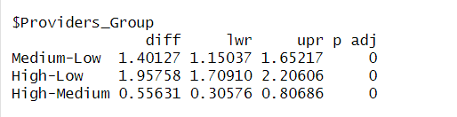
TUKEY HSD POST HOC TEST
From the Tukey Had Post Hoc Test and Boxplot we can see that counties with high Mental Health providers have High Depression prevalence

Slide 21
SPECIFIC QUESTION 2 CONCLUSION
The analysis shows that having more mental health providers does not directly lower depression rates. In fact, counties with more health care providers tend to have slightly higher depression rates.

Slide 22
SMART QUESTIONS 3 & 4
How household income is related with the number of maternal deaths and drug overdose deaths?

Slide 23
Variables
Median Household Income
Total Number of Maternal Death
Total Number of Drug Overdose Death

Slide 24
EDA
Histogram
Boxplot

Slide 25
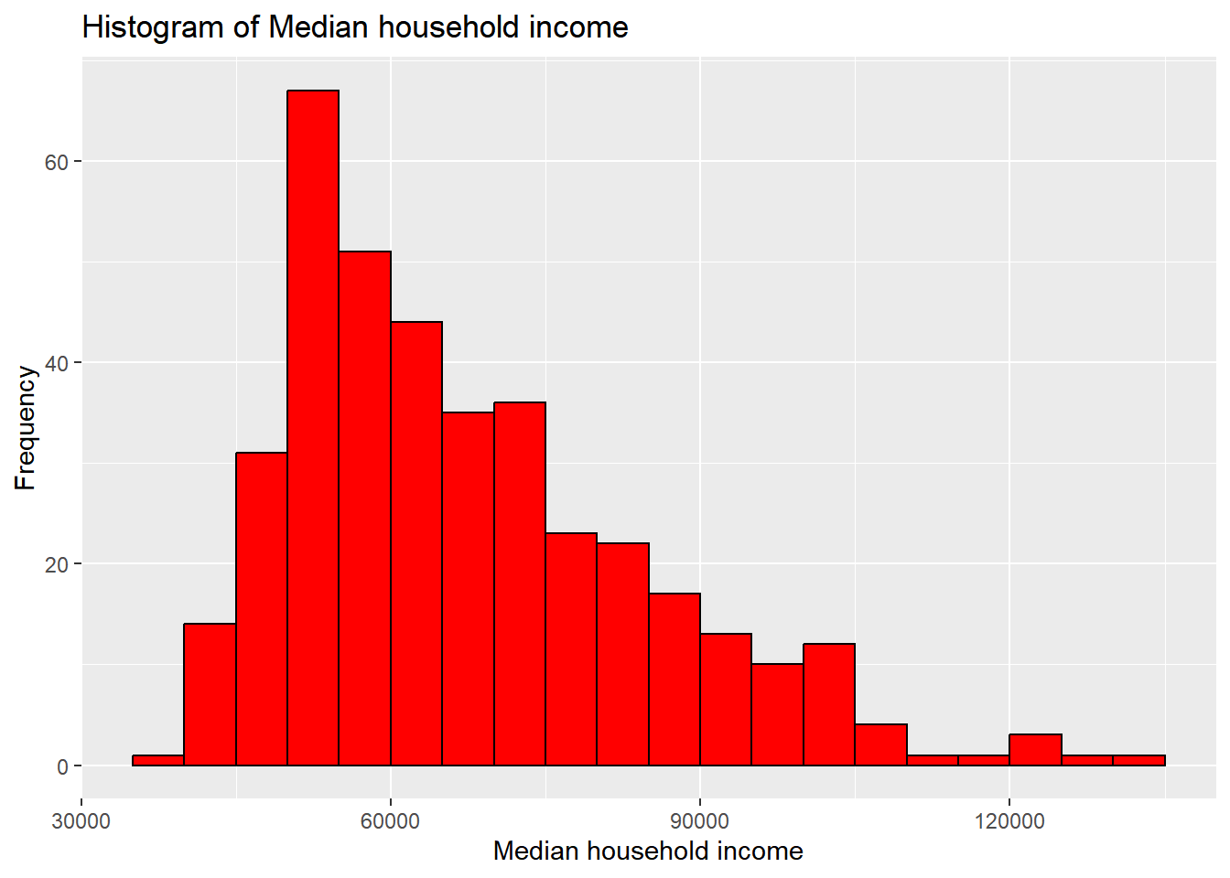
HISTOGRAM for Median Household Income

Slide 26
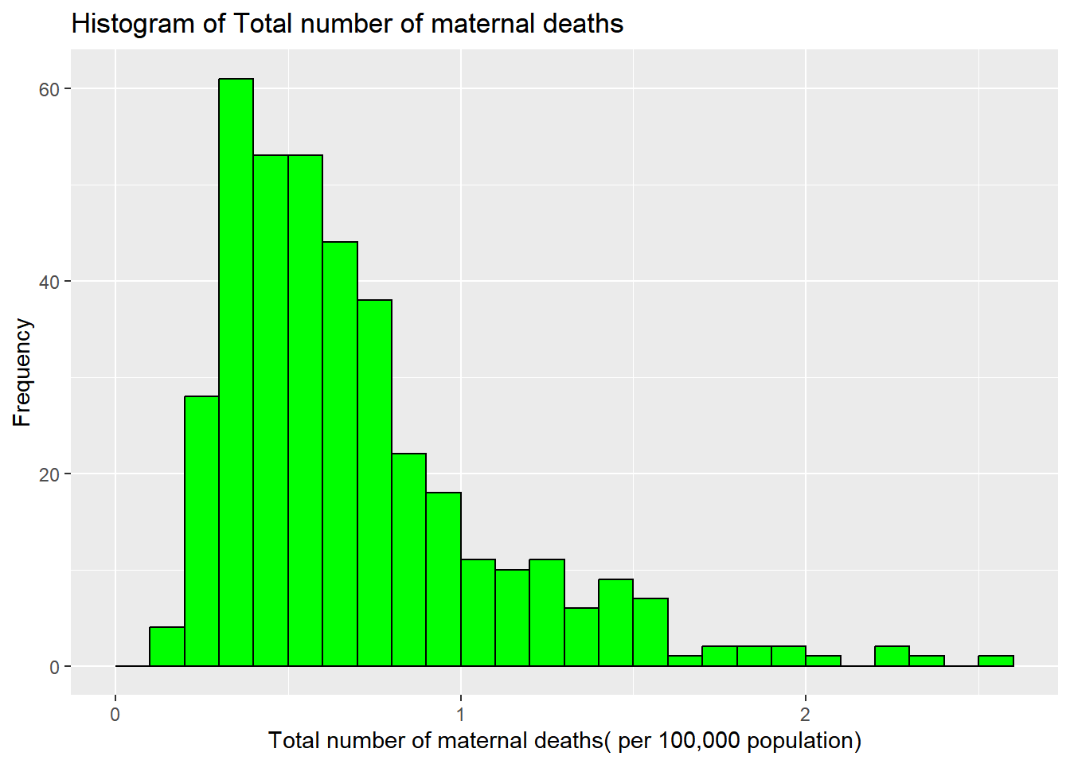
HISTOGRAM for Total Number of Maternal Deaths

Slide 27
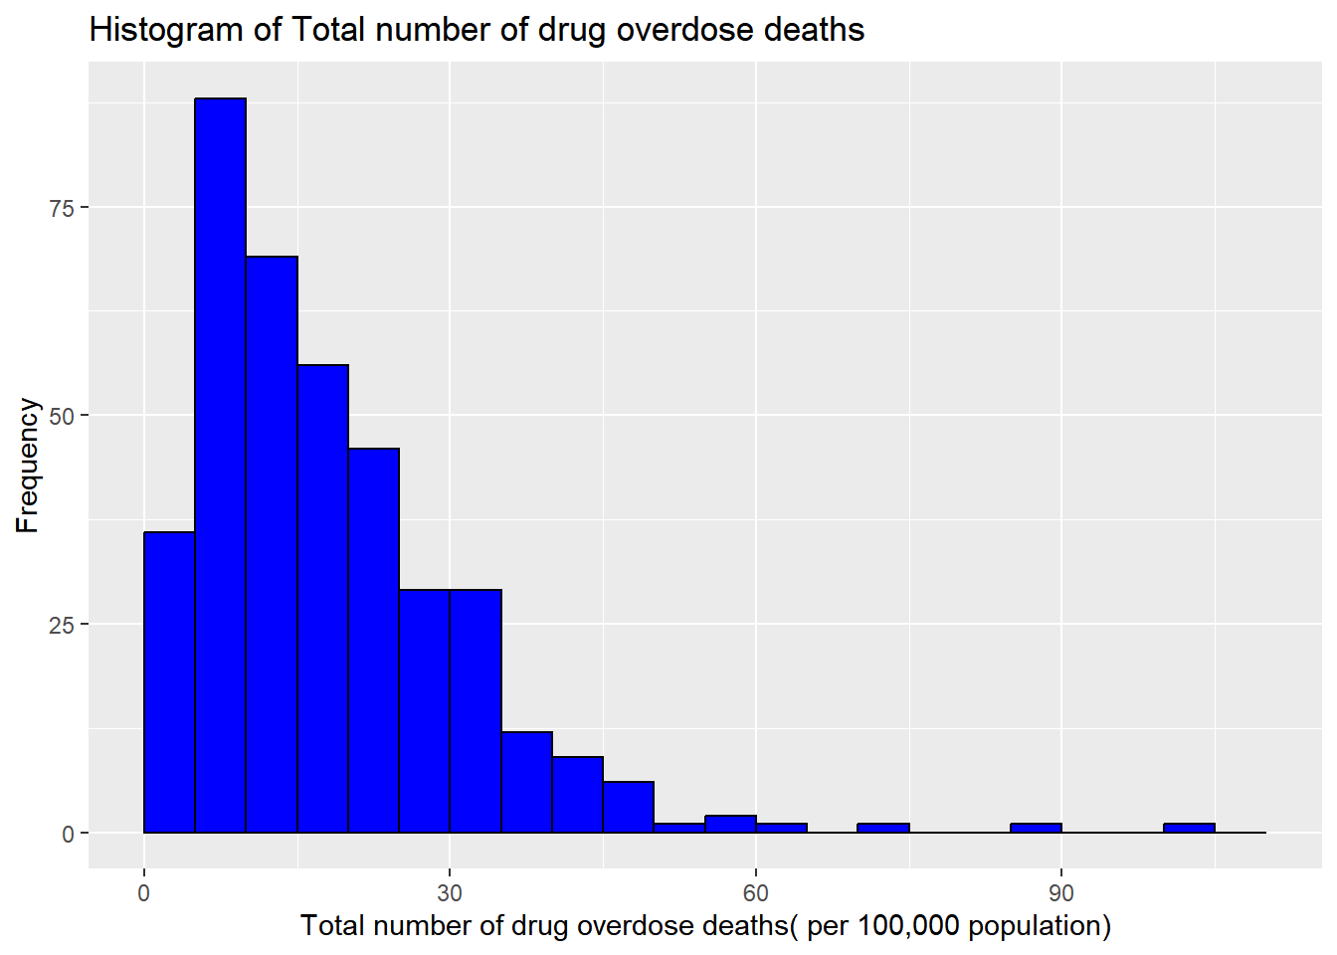
HISTOGRAM for total number of drug overdose death rates

Slide 28
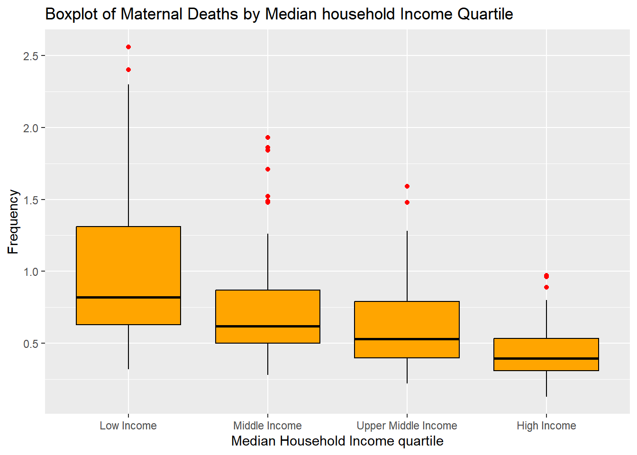
Boxplot of Maternal Deaths by Grouped Median Household Income

Slide 29
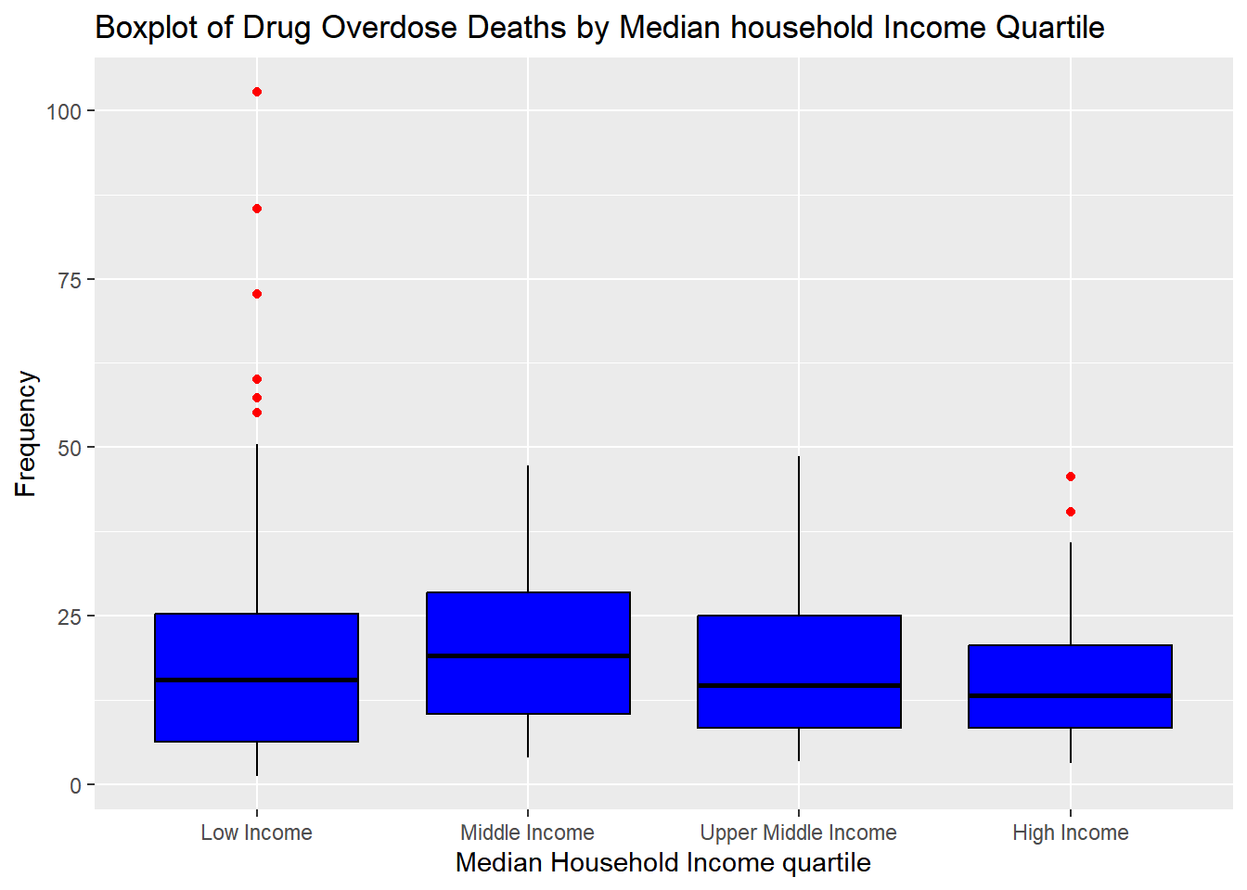
Boxplot of Drug Overdose Deaths by Grouped Median Household Income

Slide 30
ANOVA TEST
Whether the means are the same among different income groups.

Slide 31
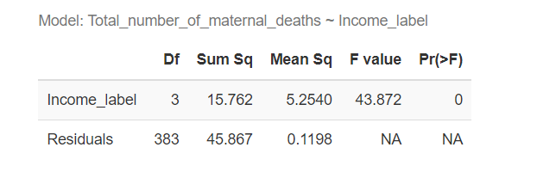
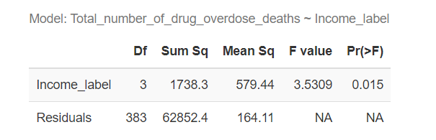
ANOVA Test Results
The means are not all the same among different income groups for two dependent variables.

Slide 32
Post-hoc Tukey HSD Test
All pairs of sample means are to be tested

Slide 33

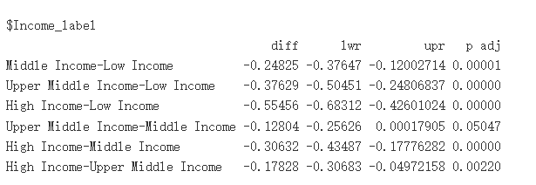
Post-hoc Tukey HSD Test Results for Maternal Death

Slide 34
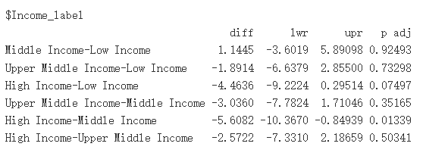
Post-hoc Tukey HSD Test Results for Drug Overdose Deaths

Slide 35
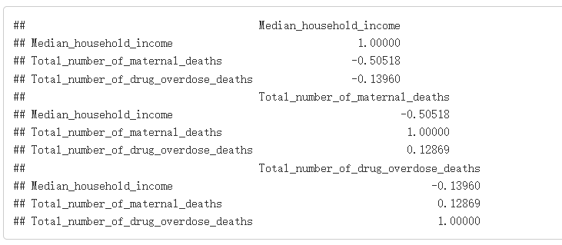
Correlation Matrix

Slide 36
Specific Question conclusion
Income levels are strongly related to Maternal Death Rate
There is very weak relation between Income and Drug overdose deaths.

Slide 37
OVERALL CONCLUSION
Unemployment Rate has a weak positive relation on drug overdose deaths.
We cannot strongly conclude that having more mental health care providers reduces depression prevalence
Income levels have a strong relation on Maternal death rates
Income levels have little to no effect on drug overdose deaths.

Slide 38
THANK YOU!

